Slide 1
PLAYER PERFORMANCE ANALYSIS WITH CLASSIFICATION & REGRESSION
ISHAK ORCUN AYDEMIR
UTKU OZYIGIT

Slide 2
player_stats
Our dataset includes 1,869 players and contains 8 features about them. The main feature we focus on is the "Rating", which we use to evaluate and compare players. In addition to the rating, the dataset includes: 'name', 'country', 'teams', 'total_maps', 'total_rounds', 'kd_diff', and 'kd'. Thanks to the Rating, we can understand whether a player is performing well or poorly. The rating itself is calculated based on several key factors:
Time Period (Performance over the last 3 months)
FirePower (Number of kills)
Entrying (Being the first player to enter and engage in a site)
Trading (The ability to trade a teammate’s death by immediately killing the opponent)
Clutching (Winning a round when left alone against multiple enemies)
Sniping (A crucial stat for players using sniper rifles)
Utility Usage (Use of grenades and other in-game utilities, which significantly impacts performance)

Slide 3
PLAYER STATISTICS & CLASS IMBALANCE
The average rating in our dataset is approximately 0.9858. Based on this value, we classify players as follows:
Players above the average rating are considered "Good" players,
Players equal to or below the average are considered "Bad" players.
As we will see shortly, this rating-based classification is distributed approximately 70% to 30%, indicating a certain degree of class imbalance in our data.

Slide 4
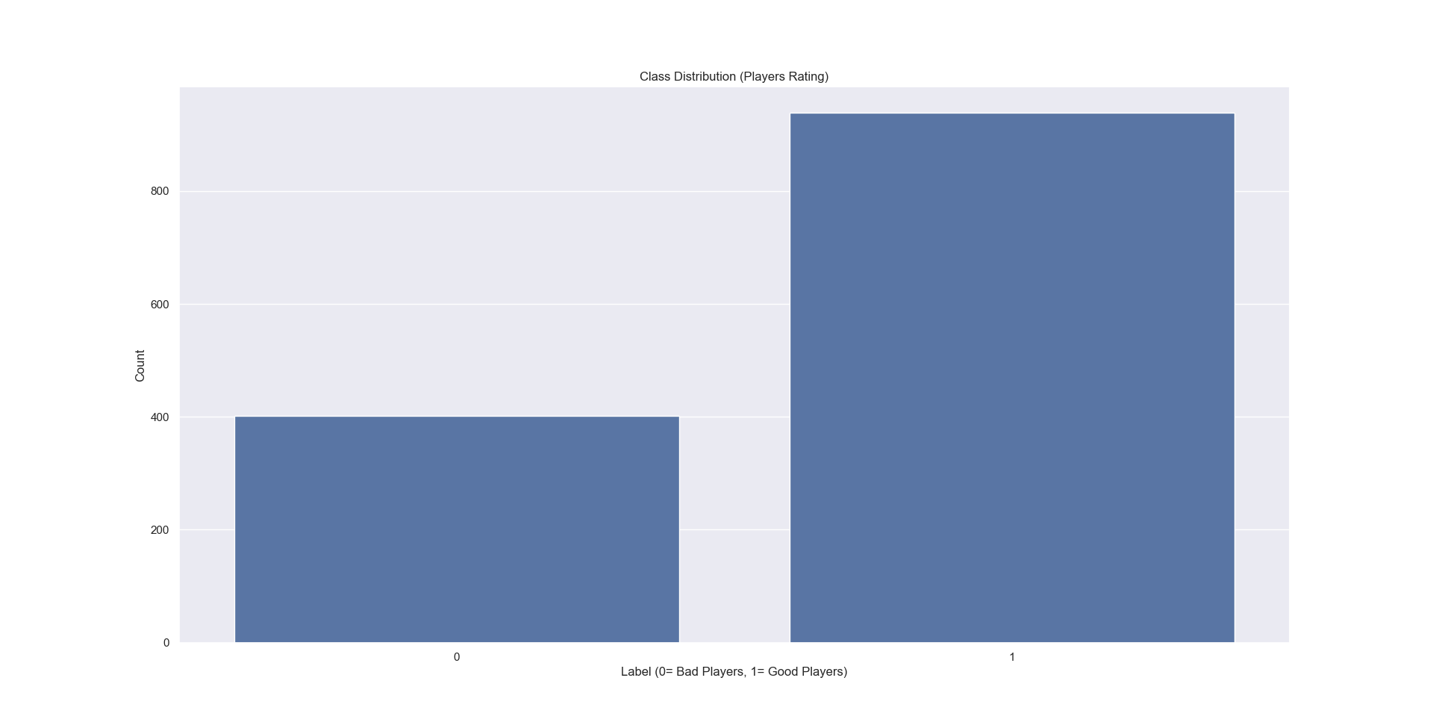

Slide 5
REGRESSION RESULTS
In this dataset, we have used Linear Regression, KNN Regression, Decision Tree, and Random Forest models. The reason we used these models is to find the most suitable algorithm to predict the players' rating values. The model that can best estimate ratings closest to the actual average rating will be considered the most accurate for our purpose. You can see all the results below.

Slide 6
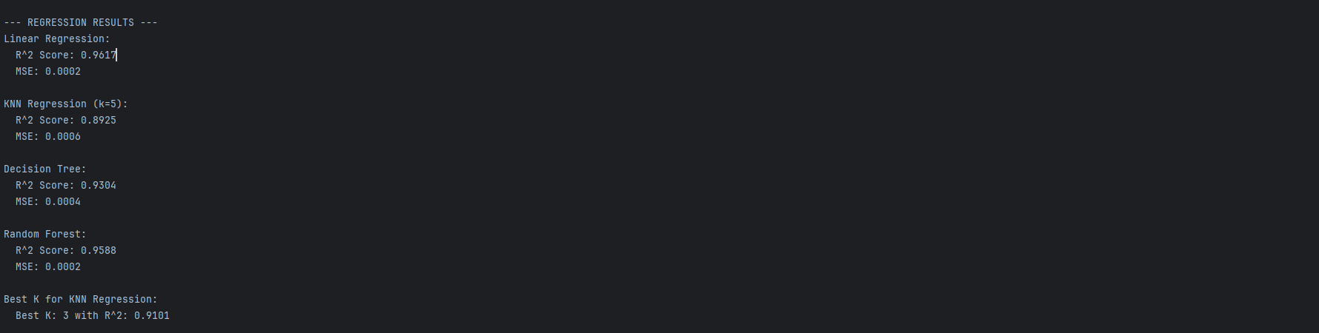
As seen above, the best performing model is Linear Regression.

Slide 7
CLASSIFICATION RESULTS
We used Logistic Regression, KNN Classifier, Decision Tree Classifier, and Random Forest Classifier to help distinguish whether the players are good or bad. For example: Rating ≥ 0.8 → 1 (good player) Rating < 0.8 → 0 (bad player) You can see the results below.

Slide 8
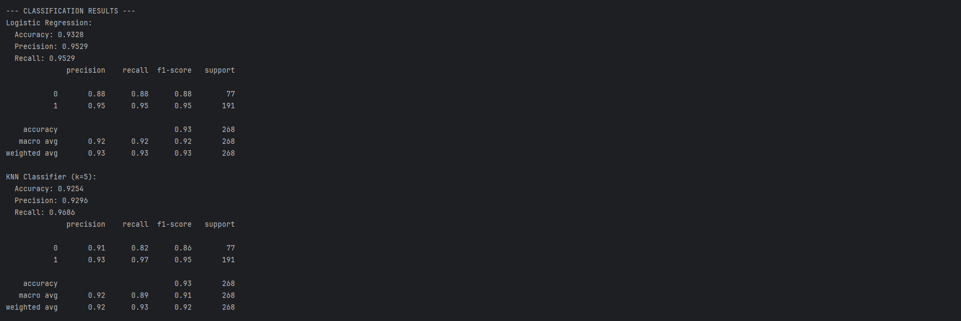
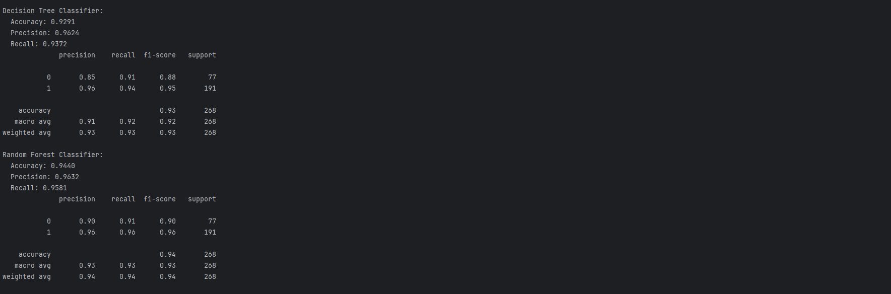

Slide 9
Based on the results above, the best performing classifier for our case is the Random Forest Classifier. It helped us make the most accurate predictions in classifying the players. Our model’s training and testing performances are quite close, and the cross-validation results are also consistent. Therefore, we can say that the model does not suffer from overfitting and it generalizes well on the data.

Slide 10
THANK YOU FOR LISTENING

